Slide 1
Sorting
SESSION 4

Slide 2
Agenda
Insertion Sort
Merge Sort
Summary

Slide 3
Introduction
Order the given elements stored in an Array, A – ascending or descending
Stable Sorting: A sorting algorithm is said to be stable if two objects with equal keys appear in the same order in sorted output as they appear in the input unsorted array
Example: Insertion Sort, Merge Sort and Bubble Sort etc.
Unstable - Quick Sort, Heap Sort etc.
An in-place algorithm is an algorithm that does not need an extra space and produces an output in the same memory that contains the data by transforming the input ‘in-place’.

Slide 4
Sorting Algorithms
WC BC AC
Bubble Sort O(n^2) O(n) O(n^2)
Selection Sort O(n^2) O(n^2) O(n^2)
Insertion Sort O(n^2) O(n^2) O(n^2)
Merge Sort O(n log n) O(n log n) O(n log n)
Quick Sort O(n^2) O(n log n) O(n log n)
Heap sort O(n log n) O(n log n) O(n log n)
Radix sort O(d(n+k)) O(d(n+k)) O(d(n+k))
Bucket sort O(n log n) O(n+b) O(n+b)
Counting sort O(n+k) O(n+k) O(n+k)
k – no. of possible values, b – no. of buckets

Slide 5
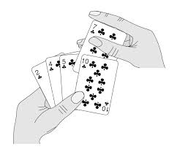
Insertion Sort
Like sorting a hand of playing cards
Start with an empty left hand and the cards facing down on the table
Remove one card at a time from the table, and insert it into the correct position in the left hand
Compare it with each of the cards already in the hand, from right to left
The cards held in the left hand are sorted
These cards were originally the top cards of the pile on the table.

Slide 6
Animation
https://youtu.be/ejpFmtYM8Cw

Slide 7
Example-1
https://www.khanacademy.org/computing/computer-science/algorithms/insertion-sort/a/insertion-sort

Slide 8
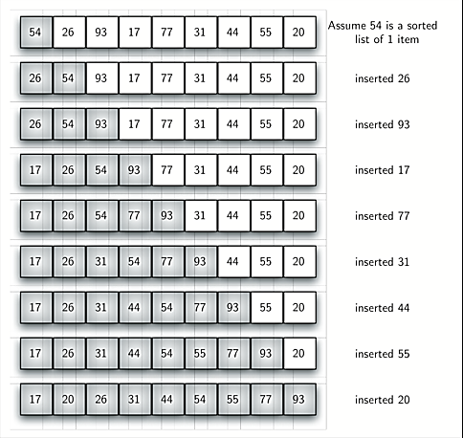
Example-2

Slide 9
Example

Slide 10
Algorithm

Slide 11
Exercise

Slide 12
Analysis
Worst-Case

Slide 13
Best-Case
The best case for insertion sort occurs when the list is already sorted.
In this case, insertion sort requires n-1 comparisons (inner while loop need not be executed)
T(n) = O(n)

Slide 14
Average-Case
We assume that all permutations of the keys are equally likely as input.
We also assume that the keys are distinct.
We first determine how many key comparisons are done on average to insert one new element into the sorted segment.

Slide 15
Average-Case…
When we deal with entry i, how far back must we go to insert it?
Answer:
There are i possible positions: not moving at all, moving by one position up to moving by i – 1 positions.
Given randomness, these are equally likely.

Slide 16
Insertion Sort – Average Case
Average no. of comparisons =
Total =

Slide 17
Insertion Sort – Average Case
Well known
Thus, the total number of comparisons
= O(n²)

Slide 18
General D&C Algorithm
■ Algorithm DC(p, r)
// Input: Starting and ending index of a list/sublist
// Output: Boolean value/Array (depending upon the problem)
// Divide: is a subalgorithm to divide the list as n/2 each.
// Combine: is a subalgorithm to combine the subproblems.
if Small(p, r)
return G(p, r)
q ← (p + r)/2 // divide the list
return Combine(DC(p, q), DC (q + 1, r))
end DC.

Slide 19
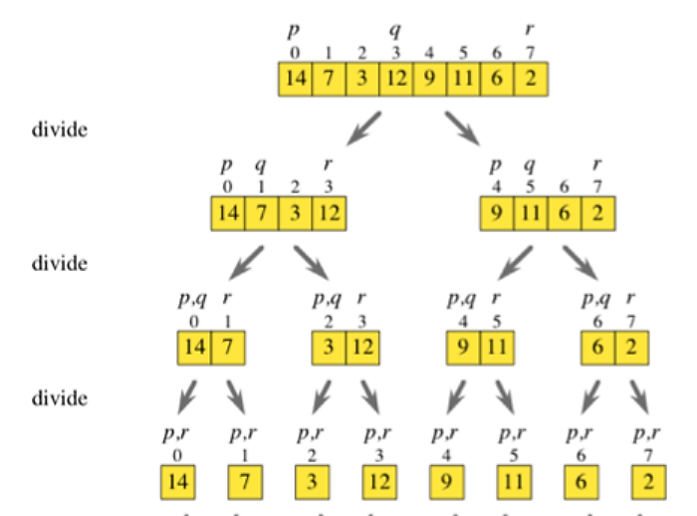
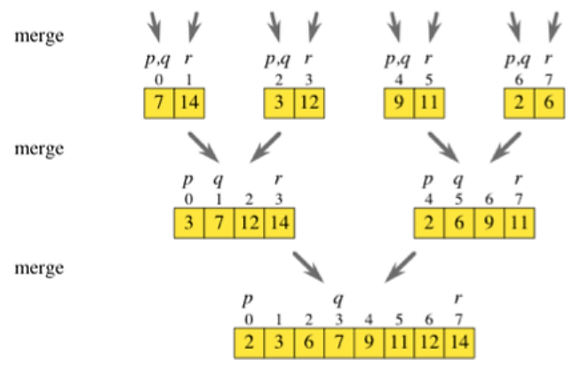
Example-1

Slide 20
Example-2
17, 5, 11, 8, 9, 3
3, 5, 8, 9, 11, 17
17, 5, 11
8, 9, 3
5, 11, 17
3, 8, 9
17, 5
11
8, 9
3
5, 17
11
8, 9
3
17
5
8
9
17
5
8
9
(a) Splitting of Array, A (b) Merging

Slide 21
Exercise

Slide 22
MergeSort
Algorithm MergeSort(a[0..n-1 ], low, high)
{
if (low < high)
{
mid ← (low+high)/2
MergeSort (a, low, mid)
MergeSort (a, mid+1, high)
Merge (a, low, mid, high)
}
}

Slide 23
What is Merge?

Slide 24
Merge
Algorithm Merge (a[0..n-1 ], low, mid, high)
{
//Local: i, h, j, k, b[MAX];
h = i = low;
j= mid + 1;
while (h<=mid && j<=high)
{
if(a[h] < a[j])
b[i++]= a[h++];
else
b[i++] =a[j++];
}
if (h > mid)
for(k = j; k <= high; k++)
b[i++] = a[k];
else
for(k=h; k<=mid; k++)
b[i++] = a[k];
for(k=low; k<=high; k++)
a[k] = b[k];
}

Slide 25
Backward Substitution Method
Sum of n natural numbers
S(n) = S(n – 1) + n for n > 0
S(0) = 0 for n = 0
Solution:
S(n) = S(n – 1) + n
Substituting (n – 1) for n, we get
S(n) = S(n – 2) + (n – 1) + n
Substituting (n – 2) for n in the original equation,
S(n) = S(n – 3) + (n – 2) +(n – 1) + n
S(n) = S(n – i) + (n – i + 1) + ….. + n i^{th} term
S(n) = S(n – n) + (n – n + 1) +….. + n n^{th} term
S(n) = S(0) + 1 + 2….. + n =

Slide 26
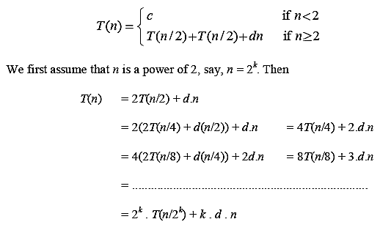
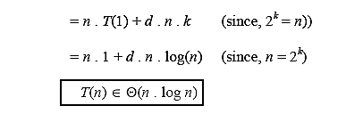
Analysis - Back Substitution

Slide 27
Alternate Method
T(1) =1 n = 1
T(n) = 2T(n/2) + n n > 1
L# | #N |  |  |  |  |  |  |  |  |  |  |  |  |  | Level sum
0 | 1 | ... | ... | .. | ... | ... |  | n |  |  | ... | ... | ... | .... | 1.n
1 | 2 | ... | ... | n/2 |  |  |  |  |  |  | n/2 |  | ... | .... | 2(n/2) = n
2 | 2² | ... | n/4 |  |  | n/4 |  |  |  | n/4 |  |  | n/4 | ... | 4(n/4) = n
3 | 2³ | n/8 |  | n/8 | n/8 |  | n/8 |  | n/8 |  | n/8 | n/8 |  | n/8 | 8(n/8) = n
.. | ... |  |  |  |  |  |  |  |  |  |  |  |  |  | ...
i | 2^{i}
h-1 | 2^{h-1}
h | 2^{h} | T(1) | T(1) | T(1) | T(1) | T(1) | T(1) | T(1) | T(1) | T(1) | T(1) | T(1) | T(1) | T(1)

Slide 28
Contd…

Slide 29
Master Theorem
where, n₀ ≥ 1, b > 1, k = 0, 1, 2, ... are constants.
Example:
e = log_{b}(a) = log₂(2) = 1
Therefore, k = e = 1 satisfies (II) of the Master Theorem,
Hence, T(n) ∈ Θ(n log n)

Slide 30
Summary

